Slide 1










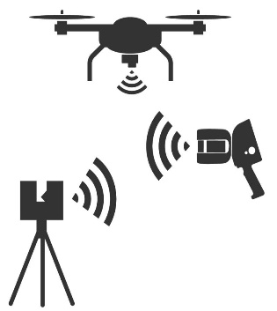





%
Modeling of forest structure attributes for Germany
h
Biomass
+
+
Optical:
Sentinel-3A (300m), MODIS (250m), AVHRR (1km)
Radar:
Envisat ASAR WSM (150m)
Sentinel-2A/B, SPOT, IKONOS
Sentinel-1A/B, TSX
➔ Sentinel-1
global coverage
up-to-date
dense time series available S1A operational since October 2014, twin satellite mode with S1B since October 2016
t
Time-series analyses for forest management monitoring
vs.
Graphics from https://ian.umces.edu/, https://www.vecteezy.com/ and https://shop.laserscanning-europe.com (accessed on 28.08.2025)
Multi-platform and multi-sensor assessment of forest structure
vs.
vs.
vs.
Investigating forest structure-biodiversity relationships
← →

